Slide 1
Web Application Development
Week 3

Slide 2
HTML Tables
An HTML table is defined with the <table> tag
Each table row is defined with the <tr> tag.
A table header is defined with <th> tag. By default table headings are bold and centered.
A table data/cell is defined with the <td> tag
Note: Most content have been taken from www.w3schools.com

Slide 3
HTML Tables
<table style="width:100%"> <tr> <th>Firstname</th> <th>Lastname</th> <th>Age</th> </tr> <tr> <td>Jill</td> <td>Smith</td> <td>50</td> </tr> <tr> <td>Eve</td> <td>Jackson</td> <td>94</td> </tr> </table>

Slide 4

HTML Tables

Slide 5
HTML Table - Adding a Border
If you do not specify a border for the table, it will be displayed without borders.
A border is set using the CSS border property:
table, th, td { border: 1px solid black; }
If you want the borders to collapse into one border, add the CSS border-collapse property:
table, th, td { border: 1px solid black; border-collapse: collapse; }

Slide 6


HTML Table - Adding a Border

Slide 7
HTML Table - Adding Cell Padding
Cell padding specifies the space between the cell content and its borders.
If you do not specify a padding, the table cells will be displayed without padding.
To set the padding, use the CSS padding property:
th, td { padding: 15px; }

Slide 8
HTML Table - Left-align Headings
By default, table headings are bold and centered
To left-align the table headings, use the CSS text-align property:
th { text-align: left; }
Border spacing specifies the space between the cells
To set the border spacing for a table, use the CSS border-spacing property:
table { border-spacing: 5px; }

Slide 9
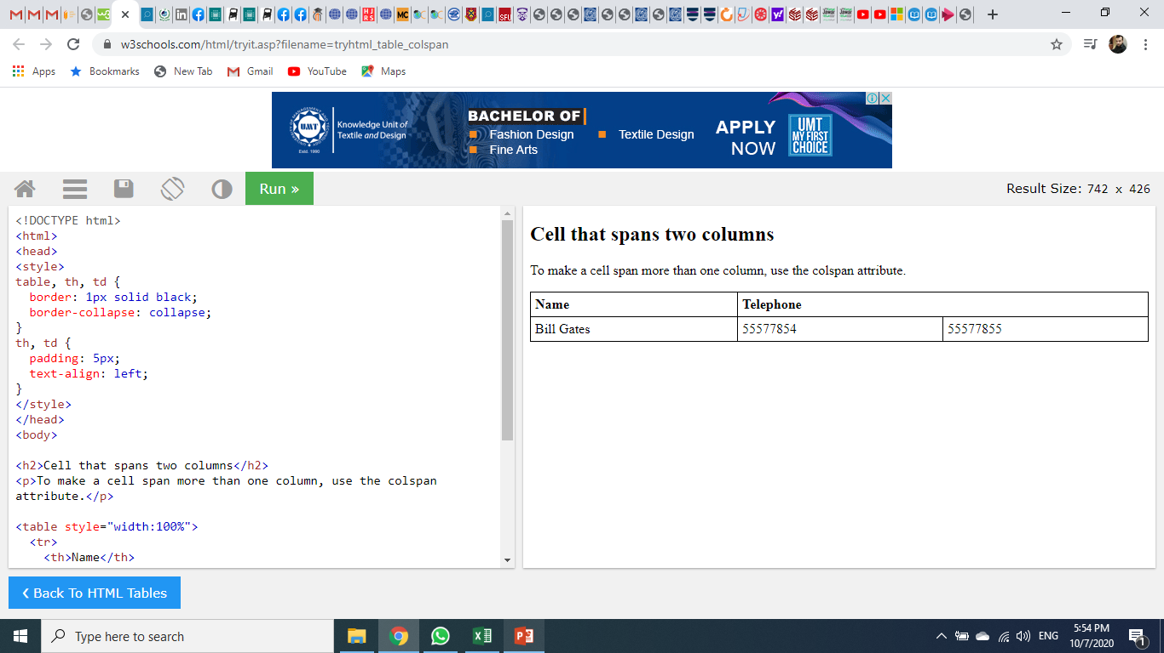
HTML Table - Cells that Span Many Columns
To make cell span more than one column, use the “colspan” attribute
<table style="width:100%"> <tr> <th>Name</th> <th colspan="2">Telephone</th> </tr> <tr> <td>Bill Gates</td> <td>55577854</td> <td>55577855</td> </tr> </table>

Slide 10
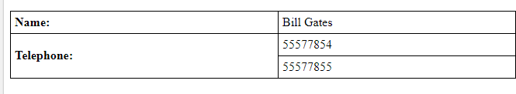
HTML Table - Cells that Span Many Rows
To make a cell span more than one row, use the “rowspan” attribute
<table style="width:100%"> <tr> <th>Name:</th> <td>Bill Gates</td> </tr> <tr> <th rowspan="2">Telephone:</th> <td>55577854</td> </tr> <tr> <td>55577855</td> </tr> </table>

Slide 11
HTML Table - Adding a Caption
To add a caption to a table, use the <caption> tag
<table style="width:100%"> <caption>Monthly savings</caption> <tr> <th>Month</th> <th>Savings</th> </tr> <tr> <td>January</td> <td>$100</td> </tr> </table>
The <caption> tag must be inserted immediately after the <table> tag

Slide 12
Table Height and Width
We can set a table width and height using width and height attributes
We can specify table width or height in terms of pixels or in terms of percentage of available screen area
<table width = “400” height = “200”> <tr> <th>Month</th> <th>Savings</th> </tr> <tr> <td>January</td> <td>$100</td> </tr> </table>

Slide 13
A Special Style for One Table
To define a special style for a special table, add an “id” attribute to the table
<table id="t01"> <tr> <th>Firstname</th> <th>Lastname</th> <th>Age</th> </tr> <tr> <td>Eve</td> <td>Jackson</td> <td>94</td> </tr> </table>
table#t01 { width: 100%; background-color: #f1f1c1; }

Slide 14
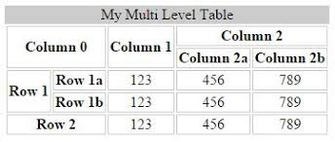
Exercise

Slide 15
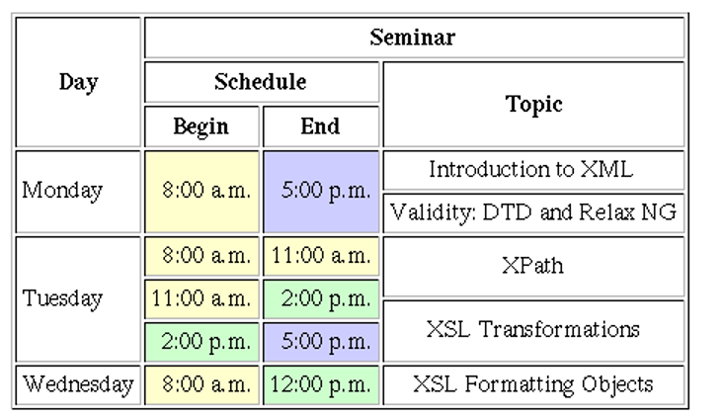
Exercise

Slide 16
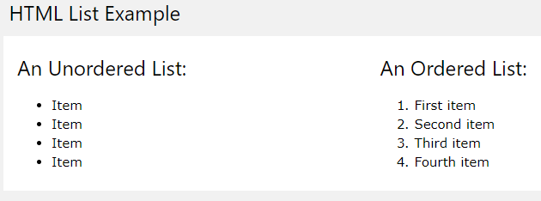
HTML Lists

Slide 17
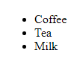
Unordered HTML List
An unordered list starts with the <ul> tag. Each list item starts with the <li> tag
The list items will be marked with bullets (small black circles) by default:
<ul> <li>Coffee</li> <li>Tea</li> <li>Milk</li> </ul>

Slide 18
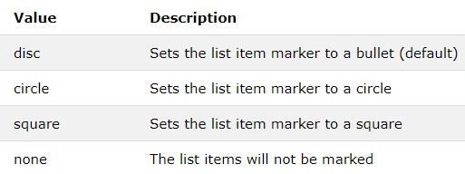
Unordered HTML List - Choose List Item Marker
The CSS list-style-type property is used to define the style of the list item maker

Slide 19
Unordered HTML List - Choose List Item Marker
<ul style="list-style-type:disc"> <li>Coffee</li> <li>Tea</li> <li>Milk</li> </ul>
<ul style="list-style-type:square"> <li>Coffee</li> <li>Tea</li> <li>Milk</li> </ul>

Slide 20
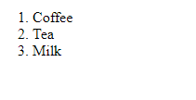
Ordered HTML List
An ordered list starts with the <ol> tag. Each list item starts with the <li> tag
The list items will be marked with numbers by default:
<ol> <li>Coffee</li> <li>Tea</li> <li>Milk</li> </ol>

Slide 21
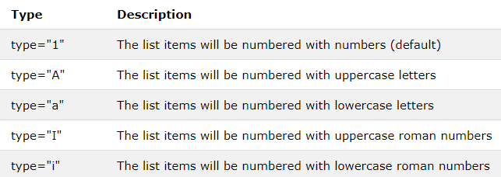
Ordered HTML List - The Type Attribute
The type attribute of the <ol> tag, defines the type of the list item marker

Slide 22
Ordered HTML List - The Type Attribute
<ol type="1"> <li>Coffee</li> <li>Tea</li> <li>Milk</li> </ol>
<ol type="A"> <li>Coffee</li> <li>Tea</li> <li>Milk</li> </ol>

Slide 23
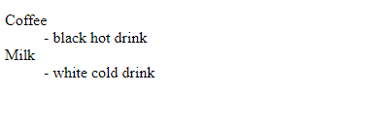
HTML Description Lists
HTML also supports description lists
A description list is a list of terms, with a description of each term.
The <dl> tag defines the description list, the <dt> tag defines the term (name), and the <dd> tag describes each term
<dl> <dt>Coffee</dt> <dd>- black hot drink</dd> <dt>Milk</dt> <dd>- white cold drink</dd> </dl>

Slide 24
Control List Counting
By default, an ordered list will start counting from 1. If you want to start counting from a specified number, you can use the “start” attribute
<ol start="50"> <li>Coffee</li> <li>Tea</li> <li>Milk</li> </ol>

Slide 25
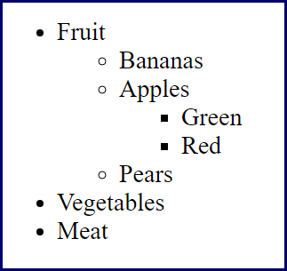
Exercise

Slide 26
HTML Blocks
All HTML elements can be categorized into two categories (a) block level elements (b) inline elements
Block Elements
Block elements appear on the screen as if they have a line break before and after them. For example, the <p>, <h1>, <h2>, <h3>, <h4>, <h5>, <h6>, <ul>, <ol>, <dl>, <pre>, and <hr /> elements are all block level elements
Inline Elements
Inline elements, on the other hand, can appear within sentences and do not have to appear on a new line of their own. The <b>, <i>, <u>, <em>, <strong>, <sup>, <sub>, <big>, <small>, <li>, <ins>, and <del> elements are all inline elements

Slide 27
HTML Forms
The HTML <form> element defines a form that is used to collect user input
<form>
.
… form elements …
.
</form>
An HTML form contains form elements.
Form elements are different types of input elements, like text fields, checkboxes, radio buttons, submit buttons and more

Slide 28
The <input> Elements
The <input> element can be displayed in several ways, depending on the type attribute. Here are some examples:
Type | Description
<input type="text"> | Defines a one-line text input field
<input type="radio"> | Defines a radio button (for selecting one of many choices)
<input type="submit"> | Defines a submit button (for submitting the form)

Slide 29
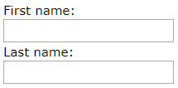
Text Input
<input type=“text”> defines one-line input field for text input
<form> First name:<br> <input type="text" name="firstname"> <br> Last name:<br> <input type="text" name="lastname"> </form>
The default width of text field is 20 characters

Slide 30
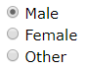
Radio Button Input
<input type=“radio”> defines a radio button
Radio buttons let a user select ONE among multiple options
<form> <input type="radio" name="gender" value="male" checked> Male<br> <input type="radio" name="gender" value="female"> Female<br> </form>
This is how the HTML code above will be displayed in a browser;

Slide 31

Checkbox Input
<input type=“checkbocx”> defines a checkbox
Checkboxes let a user select ZERO or MORE options of a limited number of choices
<form> <input type="checkbox" name="vehicle1" value="Bike"> I have a bike<br> <input type="checkbox" name="vehicle2" value="Car"> I have a car </form>
This is how the HTML code above will be displayed in a browser;

Slide 32
The Submit Button
<input type=“submit”> defines a button for submitting the form data to a form-handler
The form-handler is typically a server page with a script for processing input data.
The form-handler is specified in the form's action attribute:
<form action="/action_page.php"> First name:<br> <input type="text" name="firstname" value="Mickey"><br> Last name:<br> <input type="text" name="lastname" value="Mouse"><br><br> <input type="submit" value="Submit"> </form>

Slide 33
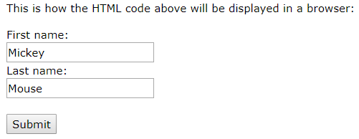
The Submit Button

Slide 34
The Target Attribute
The target attribute specifies if the submitted result will open in a new browser tab or in the current window
The default value is “_self” which means the form will be submitted in the current window
To make the form result open in a new browser tab, use the value “_blank”
Example
<form action="/action_page.php" target="_blank">

Slide 35
The Method Attribute
The method attribute specifies the HTTP method (GET or POST) to be used when submitting the form data
Example:
<form action="/action_page.php" method="get">
Or
Example:
<form action="/action_page.php" method="post">

Slide 36
When to Use GET?
The default method when submitting form data is GET
However, when GET is used, the submitted form data will be visible in the page address field:
/action_page.php?firstname=Mickey&lastname=Mouse
Notes on GET
Appends form-data into the URL in name/value pairs
The length of a URL is limited (about 3000 characters)
Never use GET to send sensitive data! (will be visible in the URL)
GET is better for non-secure data, like query strings in Google

Slide 37
When to Use POST?
Always use POST if the form data contains sensitive or personal information.
The POST method does not display the submitted form data in the page address field
Notes on POST
POST has no size limitations, and can be used to send large amounts of data.
Form submissions with POST cannot be bookmarked
Each input field must have a name attribute otherwise the data of that input field will not be sent

Slide 38
The <select> Element
The <select> element defines a drop-down list
<select name="cars"> <option value="volvo">Volvo</option> <option value="saab">Saab</option> <option value="fiat">Fiat</option> <option value="audi">Audi</option> </select>
Visible value
Use the size attribute to specify the number of visible values

Slide 39
Allow Multiple Selections
Use the multiple attribute to allow the user to select more than one value
<select name="cars" size="4" multiple> <option value="volvo">Volvo</option> <option value="saab">Saab</option> <option value="fiat">Fiat</option> <option value="audi">Audi</option> </select>

Slide 40
The <textarea> Element
The <textarea> defines a multi-line input field
<textarea name="message" rows="10" cols="30"> The cat was playing in the garden. </textarea>
You can also define the size of the text area by using CSS
<textarea name="message" style="width:200px; height:600px"> The cat was playing in the garden. </textarea>

Slide 41
The <button> Element
The <button> element defines a clickable button
<button type="button" onclick="alert('Hello World!')">Click Me!</button>
Input Type Password
<input type=“password”> defines a password field
<form> User name:<br> <input type="text" name="username"><br> User password:<br> <input type="password" name="psw"> </form>

Slide 42
Input Type Reset
<input type=“reset”> defines a reset button that will reset all form values to their default values
<form action="/action_page.php"> First name:<br> <input type="text" name="firstname" value="Mickey"><br> Last name:<br> <input type="text" name="lastname" value="Mouse"><br><br> <input type="submit" value="Submit"> <input type="reset"> </form>

Slide 43
HTML 5 Input Types
Html5 added several new input types:
color
date
email
month
number
range
time
url
week

Slide 44
HTML Input Attributes
The Value attribute specifies the initial value for an input field
<form action=""> First name:<br> <input type="text" name="firstname" value="John"> </form>
The readonly attribute specifies that the input field is read only
<form action=""> First name:<br> <input type="text" name="firstname" value="John" readonly> </form>

Slide 45
HTML Input Attributes
The disabled attribute specifies that the input field is disabled
A disabled input field is unusable and un-clickable, and its value will not be sent when submitting the form
<form action=""> First name:<br> <input type="text" name="firstname" value="John" disabled> </form>
The size attribute specifies the size (in characters) for the input field
<form action=""> First name:<br> <input type="text" name="firstname" value="John" size="40"> </form>

Slide 46
HTML Input Attributes
The maxlength attribute specifies the maximum allowed length for the input field
<form action=""> First name:<br> <input type="text" name="firstname" maxlength="10"> </form>
With a mqxlength attribute, the input field will not accept more than the allowed number of characters
The maxlength attribute does not provide any feedback. If you want to alert the user, you must write JavaScript code

